Slide 1
TCP & UDP
Protocols

Slide 2
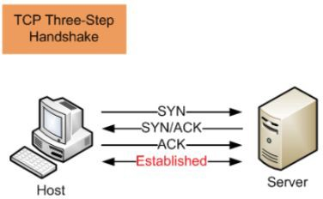
What is Transmission Control Protocol (TCP)?
Connection-oriented protocol
Reliable, ordered, and
error-checked communication
Ensures data reaches the destination correctly

Slide 3
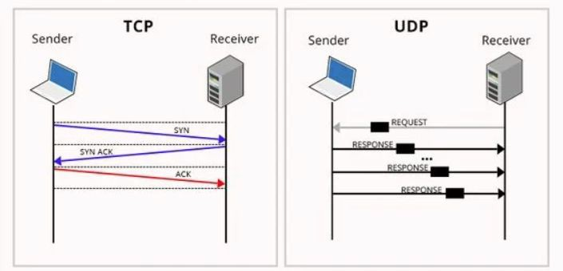
What is User Datagram Protocol (UDP)?
Connectionless protocol
Faster, but no delivery guarantees
No retransmission of lost packets

Slide 4
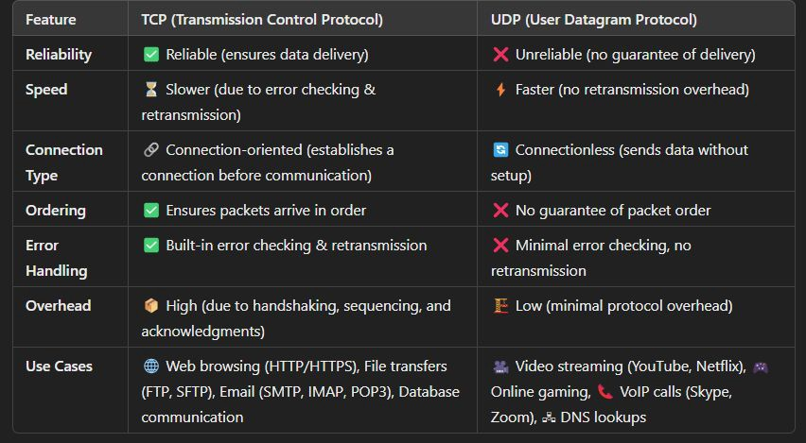
Key Differences Between TCP & UDP
Reliability: TCP (Yes), UDP (No)
Speed: TCP (Slower), UDP (Faster)
Connection Type: TCP (Connection-oriented), UDP (Connectionless)

Slide 5
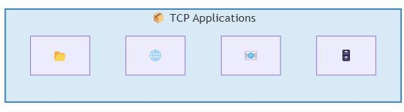
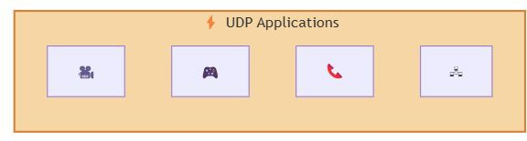
Use Cases: When to Use TCP vs. UDP
When to use TCP: If data integrity is critical, TCP is the way to go.
  Web browsing (HTTP, HTTPS)
  File transfers (FTP, SFTP)
  Email (SMTP, IMAP, POP3)
  Database communication
When to use UDP: UDP is preferred when speed is more important than reliability
  Video streaming (YouTube, Netﬂix)
  Online gaming (Multiplayer Games)
  VoIP calls (Skype, Zoom)
  DNS lookups (Domain Name System)

Slide 6
Interview Questions: TCP & UDP
Basic Questions:
  What is the diﬀerence between TCP and UDP?
  Why is TCP considered a reliable protocol?
  When would you choose UDP over TCP?
Technical & Deep-Dive:
  How does TCP ensure reliable data transmission?
  What is the Three-Way Handshake in TCP?
  How does UDP handle packet loss?
Use Case & System Design:
  Which protocol would you use for a real-time multiplayer game? Why?
  How does TCP handle congestion control?
  Why is DNS implemented over UDP instead of TCP?
  If a video streaming service is buﬀering too much, would switching from TCP to UDP help?
Pro Tip: Be prepared to compare TCP & UDP in real-world scenarios and discuss trade-oﬀs in speed vs. reliability!

Slide 7
Summary & Key Takeaways
TCP is reliable but slower; UDP is fast but unreliable.
TCP is best for web pages, ﬁle transfers, and email.
UDP is best for real-time applications like video calls and gaming.
System design must balance speed, reliability, and user experience.
What’s Next:
  HTTP - The Backbone of the Web

